Slide 1
Turbulent Boundary Layer
Fluid Mechanics II
Course November 16
Advanced Fluid Dynamics

Slide 2
The phenomena observed during the transition process are similar for the flat plate boundary layer and for the plane channel flow, as shown in the following figure based on measurements by M. Nishioka et al. (1975). Periodic initial perturbations were generated in the BL using an oscillating cord. For typical commercial surfaces transition occurs at Re , 5x10⁵ However, the transition can be delayed to Re 3X10⁶ by different ways such as having very smooth walls and/or very low turbulent wind tunnel.

Slide 3
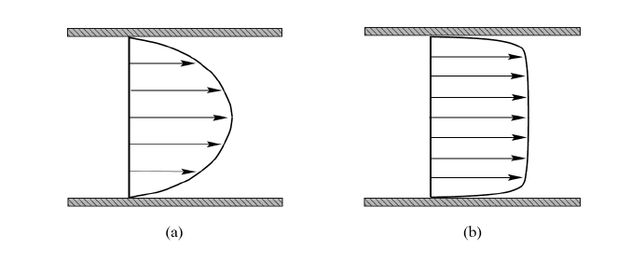
Velocity profile in duct
Comparison of laminar and turbulent velocity profiles in duct; a) laminar, b) turbulent
in the turbulent case, and is completely dominated by viscous effects. This inner layer is termed as the viscous sublayer; velocity varies linearly with distance from the wall. The so-called ”outer region” or called also as inertial sublayer, shows nearly constant velocity with distance from the wall.

Slide 4
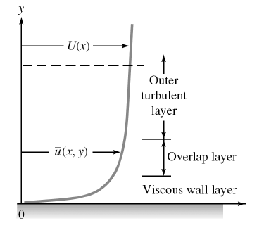
1. Wall layer: Viscous shear dominates.
2. Outer layer: Turbulent shear dominates.
3. Overlap layer: Both types of shear are important.

Slide 5

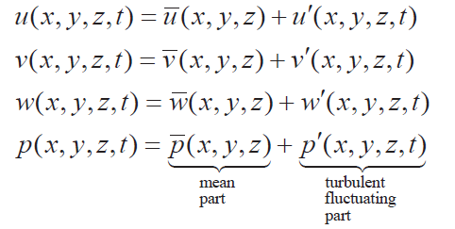
Reynolds Average of 2D boundary layer equations
In a turbulent flow, we can define the mean, steady flow as:
This allows us to split the flow properties into a mean and a fluctuating part:

Slide 6


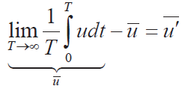


Reynolds Average of 2D boundary layer equations
Note: the mean of u´ is zero:
Now, we will develop equations which govern the mean flow and try to develop some insight into how the fluctuations alter the mean flow equations.

Slide 7
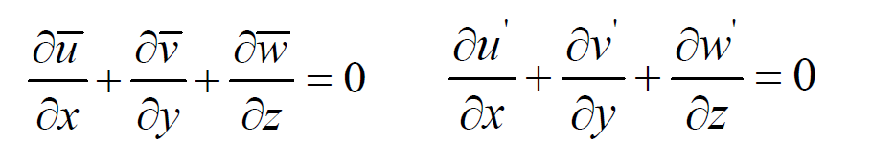

Reynolds Average of 2D boundary layer equations
Substituting u, v and w into continuity equation and taking the time average we obtain,
Similarly for the momentum equations and using continuity (neglecting g),

Slide 8
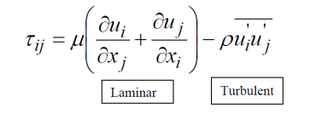
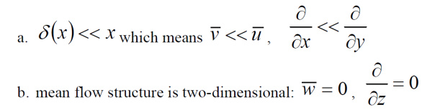
Reynolds Average of 2D boundary layer equations
Where
Assume

Slide 9




Reynolds Average of 2D boundary layer equations
Note the mean lateral turbulence is actually not zero, $\overline{w^{´2}}$ but its z
derivative is assumed to vanish.
Then, we get the following Reynolds averaged BL equations for 2D incompressible steady flow
Continuity
x-momentum
Where Ue is the free-stream velocity and
y-momentum

Slide 10
Reynolds Average of 2D boundary layer equations
To solve the above equations:
  The equations are solved for the time averages u and v
  The shear stress now consists of two parts:
    1. first part is due to the molecular exchange and is computed from the time-averaged field as in the laminar case;
    2. The second part appears additionally and is due to turbulent motions.
  The additional term is new unknown for which a relation with the average field of the velocity must be constructed via a turbulence model.

Slide 11



Reynolds Average of 2D boundary layer equations
Integrate y- momentum equation across the boundary layer
So, unlike laminar BL, there is a slight variation of pressure across the turbulent BL due to velocity fluctuations normal to the wall, which is no more than 4% of the stream velocity and thus can be neglected.
The Bernoulli relation is assumed to hold in the inviscid free-stream:
The boundary conditions:

Slide 12
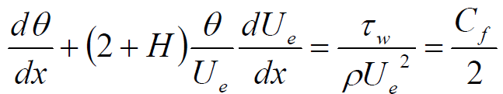

Momentum Integral Equations valid for BL solutions
The momentum integral equation has the identical form as the laminar-flow relation:
For laminar flow:
( C_{f,} θ, H )are correlated in terms of simple parameter
For Turbulent flow:
( C_{f,} θ, H ) can not be correlated in terms of simple parameter
Additional parameters and relationships are required that model the influence of the turbulent fluctuations. There are many possibilities all of which require a certain amount of empirical data.

Slide 13







Flat plate boundary layer (zero pressure gradient)
1. Log law analysis of Smooth flat plate
Assume log-law can be used to approximate turbulent velocity profile
and use to get Cf=Cf(δ) relationship
: Friction Velocity
At y=δ (edge of boundary layer)
However:
=

Slide 14





Flat plate boundary layer (zero pressure gradient)
Following a suggestion of Prandtl, we can forget the complex log law
and simply use a power-law approximation:
Use u /U_{e} profile to get θ, Cf, δ, δ*, and H for smooth plate

Slide 15









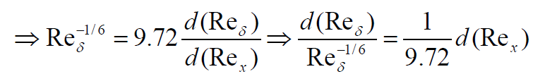

Flat plate boundary layer (zero pressure gradient)
From Log law or
Example:
=

Slide 16






Flat plate boundary layer (zero pressure gradient)
Turbulent BL has almost linear growth rate which is much faster than
laminar BL which is proportional to x^{1/2}.
Other properties:
Decreases slowly with x, increases with ρ and U² and insensitive to μ

Slide 17






Boundary layer with pressure gradient
Continuity
Momentum X-component
Where
The pressure gradient term has a large influence on the solution. In
particular, adverse pressure gradient (i.e. increasing pressure) can cause
flow separation. Recall that the y momentum equation subject to the
boundary layer assumptions reduced to
That is, pressure (which drives BL equations) is given by external
inviscid flow solution which in many cases is also irrotational.

Slide 18
Boundary layer with pressure gradient
Continuity
Momentum X-component
Where
The pressure gradient term has a large influence on the solution. In
particular, adverse pressure gradient (i.e. increasing pressure) can cause
flow separation. Recall that the y momentum equation subject to the
boundary layer assumptions reduced to

Slide 19


Boundary layer with pressure gradient
Even without solving the BL equations we can deduce information about
the shape of the velocity profiles just by evaluating the BL equations at
the wall (y = 0)
which, shows that the curvature of the velocity profile at the wall is
related to the pressure gradient.
Effect of Pressure Gradient on Velocity Profiles
Point of inflection: a point where a graph changes between concave
upward and concave downward.

Slide 20
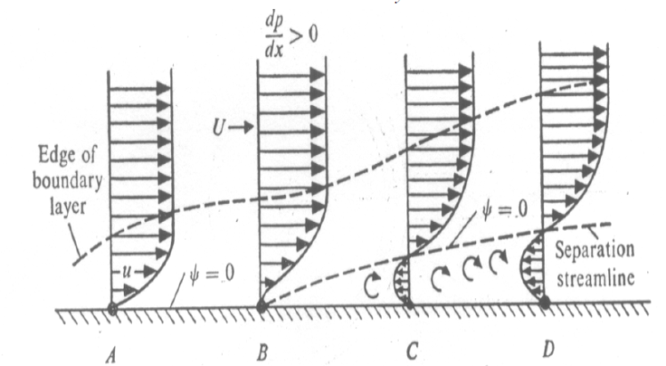
Boundary layer with pressure gradient
Separation Condition

Slide 21
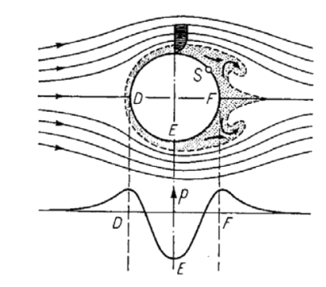
Boundary layer with pressure gradient
Separation Condition
1. D to E, pressure drop, pressure is transformed into kinetic energy.
2. From E to F, kinetic energy is transformed into pressure.
3. A fluid particle directly at the wall in the boundary layer is also
acted upon by the same pressure distribution as in the outer flow
(inviscid).
4. Due to the strong friction forces in the BL, a BL particle loses so
much of its kinetic energy that is cannot manage to get over the
“pressure gradient” from E to F.

Slide 22
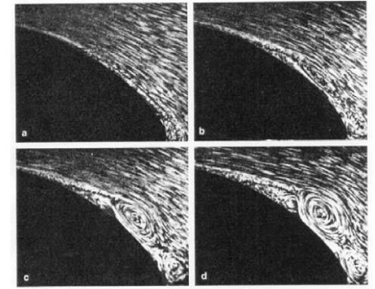
Boundary layer with pressure gradient
Separation Condition
a. reversed motion begun at the trailing edge
b. boundary layer has been thickened, and start of the reversed
motion has moved forward considerably.
c. and d. a large vortex formed from the backflow and then soon
separates from the body.

Slide 23
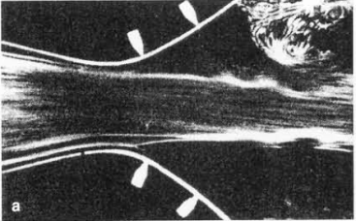
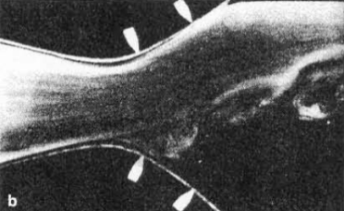
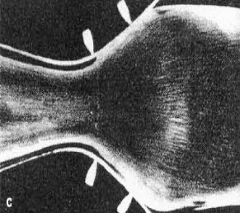

Boundary layer with pressure gradient
Separation Condition Diffuser flow:

Slide 24
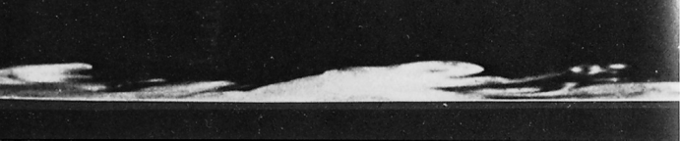
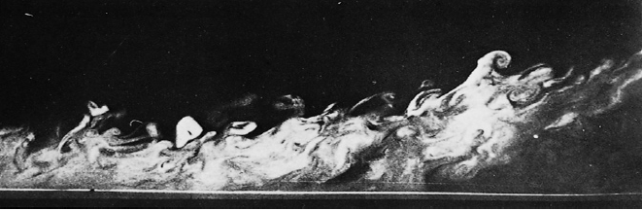
Flat plate boundary layer
A strong negative pressure gradient may re-laminarize a flow
A strong positive pressure gradient causes a strong boundary
layer top thicken.

Slide 25
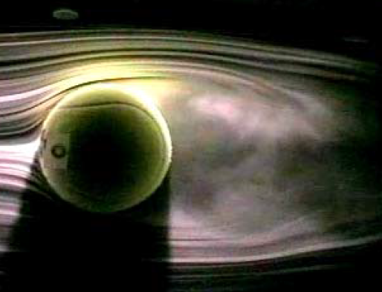
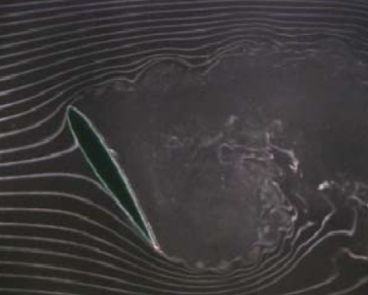
Boundary layer with pressure gradient
Separation Condition Diffuser flow:

Slide 26
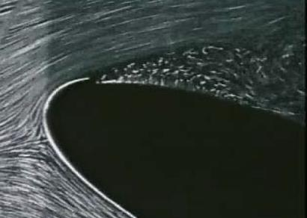
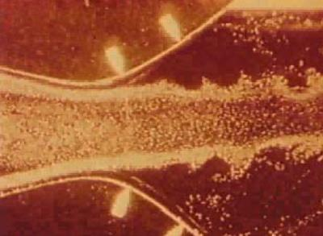
Boundary layer with pressure gradient
Separation Condition Diffuser flow:

Slide 27
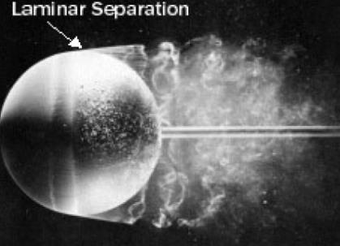
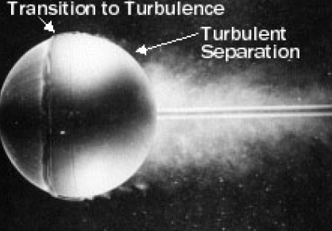
Boundary layer with pressure gradient
Separation Condition Diffuser flow:

Slide 28
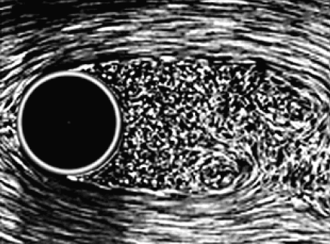
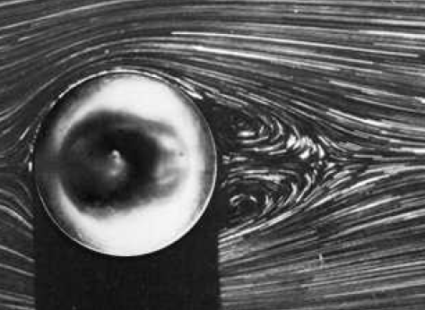
Boundary layer with pressure gradient
Separation Condition Diffuser flow:

Slide 29
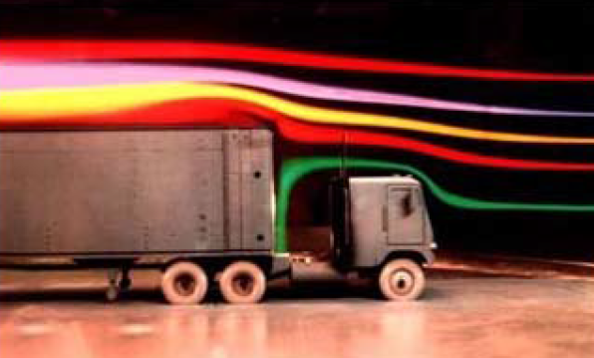
Boundary layer with pressure gradient
Separation Condition Diffuser flow:

Slide 30
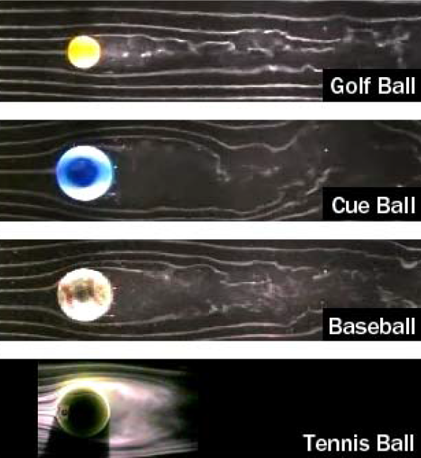
Boundary layer with pressure gradient
Separation Condition Diffuser flow:

